Slide 1
Using a Venn diagram to display outcomes for more than two events
Probability: possible outcomes

Slide 2
How our teaching resources are designed for the classroom

Slide 3
I can systematically find all the possible outcomes for more than two events by using a Venn diagram.

Slide 4
Venn diagrams are a representation used to model statistical/probability questions. Commonly circles are used to represent events.

Slide 5

Using a Venn diagram to display outcomes for more than two events
Venn diagrams
Outcomes from a Venn diagram

Slide 6
Venn diagrams
When this spinner is spun the outcomes are {1, 2, 3, 4, 5, 6, 7, 8, 9, 10}, we call this the sample space.
3
4
The outcomes can be sorted into a Venn diagram for two events.
2
5
1
6
For example: Event A = {even number}
Event B = {factor of 20}
10
7
ξ
9
8
A
B
1
6
2
If a third event {square number} was added, is there a way to show this on a Venn diagram?
4
8
5
10
7
9
3

Slide 7
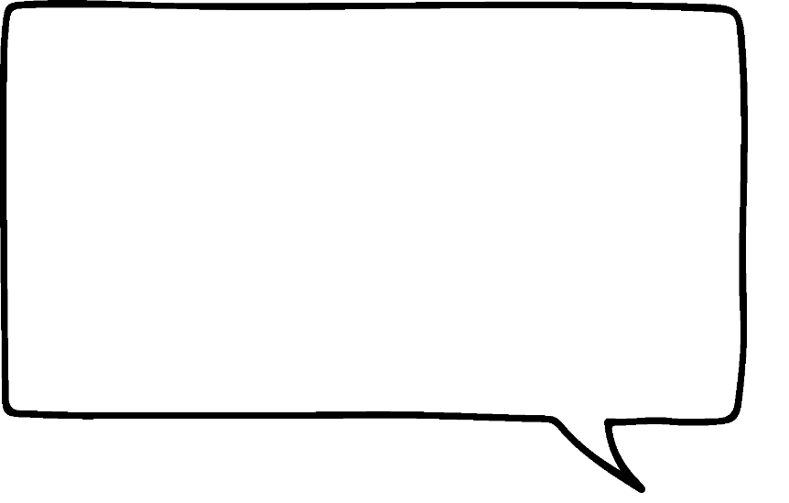
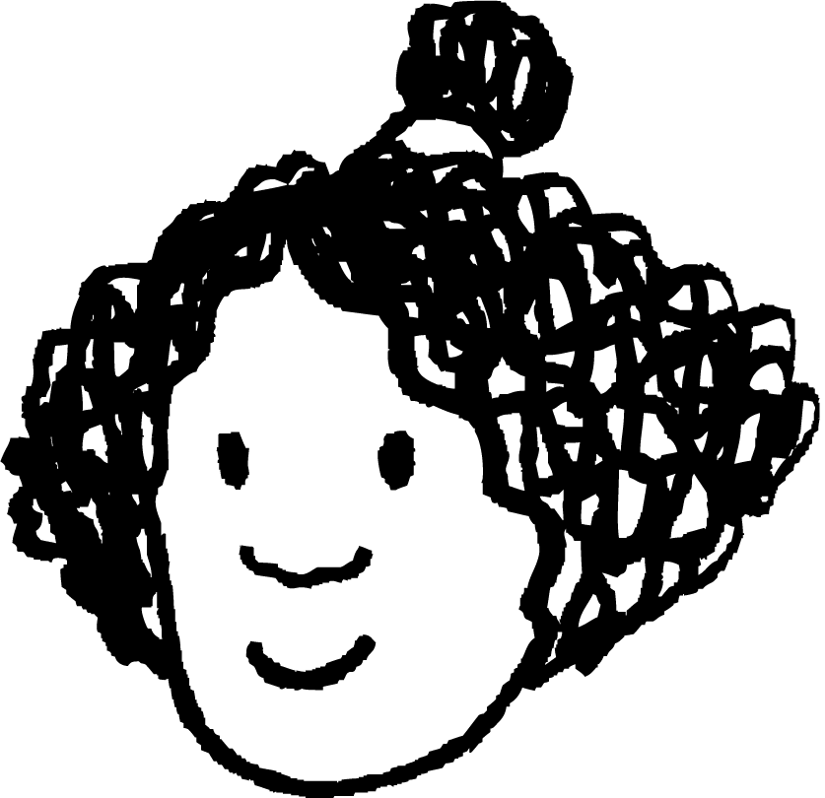
Venn diagrams
If event A = {even number}, event B = {factor of 20} and event C = {square number}.
3
4
ξ
B
2
5
A
C
1
6
6
2
1
Maybe the structure of the Venn diagram would look like this, just an extra circle.
10
7
4
9
8
8
10
5
7
9
3
Does each event have the correct outcomes?
No, {4} is a square number as well as being even and a factor of 20.
Izzy

Slide 8
Venn diagrams
If event A = {even number}, event B = {factor of 20} and event C = {square number}.
3
4
ξ
B
2
5
A
C
1
6
6
2
1
So event C needs to intersect with both events A and B. Is there a way to do that?
10
7
4
9
8
8
10
5
7
9
3
Does each event have the correct outcomes?
No, {4} is a square number as well as being even and a factor of 20.
Izzy

Slide 9
Venn diagrams
If event A = {even number}, event B = {factor of 20} and event C = {square number}.
The outcome of {4} is now in the intersection of all three events.
3
4
ξ
2
5
A
B
6
2
5
1
6
10
10
7
8
4
This structure seems to work. Each event intersects with each of the other events.
9
8
1
7
C
9
3
Izzy

Slide 10
Venn diagrams
If event A = {even number}, event B = {factor of 20} and event C = {square number}.
This intersection is for outcomes in event B and event C. Factors of 20 that are also square numbers.
3
4
ξ
2
5
A
B
6
2
5
1
6
10
10
7
8
4
9
8
1
7
C
9
3

Slide 11
Venn diagrams
If event A = {even number}, event B = {factor of 20} and event C = {square number}.
This intersection is for outcomes in event B and event C but not in event A. Factors of 20 that are also square numbers but not even.
3
4
ξ
2
5
A
B
6
2
5
1
6
10
10
7
8
4
9
8
1
7
C
9
3

Slide 12
Venn diagrams
What does the shaded section of the Venn diagram represent?
ξ
Outcomes that are in event A and event C but not in event B.
A
B
C

Slide 13
Venn diagrams
What does the shaded section of the Venn diagram represent?
ξ
Outcomes that are only in event A.
A
B
C

Slide 14
Venn diagrams
This Venn diagram represents some pupils.
A = {visited Spain}
ξ
B = {visited France}
C = {visited America}
A
B
Jacob
We can see from the Venn diagram
that 8 pupils are represented
that 1 pupil has not visited Spain, France nor America
that 4 pupils have visited America
that 2 pupils have visited both France and America
Lucas
Sam
Aisha
Jun
Izzy
Alex
C
Andeep

Slide 15
Venn diagrams
This Venn diagram represents some pupils.
A = {visited Spain}
ξ
B = {visited France}
C = {visited America}
A
B
Jacob
Who has visited Spain?
Lucas
Sam
Aisha
Lucas, Sam and Jun
Jun
Izzy
Alex
C
Andeep

Slide 16
Venn diagrams
This Venn diagram represents some pupils.
A = {visited Spain}
ξ
B = {visited France}
C = {visited America}
A
B
Jacob
Who has visited Spain, France and America?
Lucas
Sam
Aisha
Sam
Jun
Izzy
Alex
C
Andeep

Slide 17
Venn diagrams
This Venn diagram represents some pupils.
A = {visited Spain}
ξ
B = {visited France}
C = {visited America}
A
B
Jacob
Who has only visited France?
Lucas
Sam
Aisha
Jacob and Aisha
Jun
Izzy
Alex
C
Andeep

Slide 18
Venn diagrams
The Venn diagram shows the menu choices of 8 pupils.
Starter
ξ
G
F
Garlic mushrooms (G)
Jacob
Andeep
Alex
Halloumi bites (H)
Aisha
Jun
Main
Bacon cheeseburger (C)
Izzy
Sam
Fish and chips (F)
Lucas
Vegetable curry (V)
I
Dessert
Ice Cream (I)
We know the three courses chosen for some of the pupils.
Fruit Salad (S)

Slide 19
Venn diagrams
The Venn diagram shows the menu choices of 8 pupils.
Starter
ξ
G
F
Garlic mushrooms (G)
Jacob
Andeep
Alex
Halloumi bites (H)
Aisha
Jun
Main
Bacon cheeseburger (C)
Izzy
Sam
Fish and chips (F)
Lucas
Vegetable curry (V)
I
Dessert
Ice Cream (I)
We know the three courses chosen for some of the pupils.
Fruit Salad (S)

Slide 20
Venn diagrams
The Venn diagram shows the menu choices of 8 pupils.
Starter
ξ
G
F
Garlic mushrooms (G)
Jacob
Andeep
Alex
Halloumi bites (H)
Aisha
Jun
Main
Bacon cheeseburger (C)
Izzy
Sam
Fish and chips (F)
Lucas
Vegetable curry (V)
I
Dessert
Ice Cream (I)
We know the three courses chosen for some of the pupils.
Fruit Salad (S)

Slide 21
Venn diagrams
The Venn diagram shows the menu choices of 8 pupils.
Starter
ξ
G
F
Garlic mushrooms (G)
Jacob
Andeep
Alex
Halloumi bites (H)
Aisha
Jun
Main
Bacon cheeseburger (C)
Izzy
Sam
Fish and chips (F)
Lucas
Vegetable curry (V)
I
Dessert
Ice Cream (I)
Whereas for others we do not know all three courses.
Fruit Salad (S)

Slide 22
Venn diagrams
The Venn diagram shows the menu choices of 8 pupils.
Starter
ξ
G
F
Garlic mushrooms (G)
Laura is now coming to the meal. She orders halloumi, vegetable curry and fruit salad. Add her to the Venn diagram.
Jacob
Andeep
Alex
Halloumi bites (H)
Aisha
Jun
Main
Bacon cheeseburger (C)
Izzy
Sam
Fish and chips (F)
Lucas
Vegetable curry (V)
I
Laura
Dessert
Ice Cream (I)
Fruit Salad (S)

Slide 23
Venn diagrams
1) A spinner has the possible outcomes of {3, 5, 6, 8, 10, 12, 15, 18, 20, 25}.
Event A = {odd numbers}, event B = {factors of 30} and event C = {multiples of 3}.
Draw a Venn diagram to show this information.
2) There are 20 playing cards. Each card is either red(R) or black(B) and a number from 1 to 10. For example, R3 is a red number 3.
Event A = {black cards}, event B = {even number} and event C = {factor of 10}.
Draw a Venn diagram to show this information.

Slide 24
Venn diagrams
3) Match the statements to the shaded areas.
ξ
A
B
ξ
A
B
ξ
A
B
C
C
C
outcomes of event A
outcomes of event B only
outcomes of event A and event B but not event C

Slide 25
Venn diagrams
1) A spinner has the possible outcomes of {3, 5, 6, 8, 10, 12, 15, 18, 20, 25}.
Event A = {odd numbers}, event B = {factors of 30} and event C = {multiples of 3}.
Draw a Venn diagram to show this information.
ξ
A
B
5
25
10
3
15
6
18
12
8
C
20

Slide 26
Venn diagrams
2) There are 20 playing cards. Each card is either red(R) or black(B) and a number from 1 to 10. For example, R3 is a red number 3.
Event A = {black cards}, event B = {even number} and event C = {factor of 10}.
Draw a Venn diagram to show this information.
ξ
A
B
B7
B4
R6
B9
R8
B8
B6
B3
R4
B10
B1
B2
R2
B5
R10
R5
R1
R7
R9
C
R3

Slide 27
Venn diagrams
3) Match the statements to the shaded areas.
ξ
A
B
ξ
A
B
ξ
A
B
C
C
C
outcomes of event A
outcomes of event B only
outcomes of event A and event B but not event C

Slide 28
Using a Venn diagram to display outcomes for more than two events
Venn diagrams
Outcomes from a Venn diagram

Slide 29
Outcomes from Venn diagrams
Here is a Venn diagram for the three events A, B and C, where:
ξ = {1, 2, 3, 4, 5, 6, 7, 8, 9, 10, 11, 12}
A = {prime number} = {2, 3, 5, 7, 11}
B = {odd number} = {1, 3, 5, 7, 9, 11}
A
B
C = {factor of 12} = {1, 2, 3, 4, 6, 12}
7
9
11
5
{9} is only odd
3
2
1
{3} is prime, odd and a factor of 12
6
12
8
4
C
10
{8, 10} are not prime nor odd nor factors of 12

Slide 30
Outcomes from Venn diagrams
Event A = {factors of 10}
Event B = {even numbers}
Event C = {multiples of 5}
Which outcome is in all three events?
ξ = {1, 2, 3, 4, 5, 6, 7, 8, 9, 10}
A
B
1
2
8
6
10
4
{10}
9
5
7
3
C

Slide 31
Outcomes from Venn diagrams
Event A = {factors of 10}
Event B = {even numbers}
Event C = {multiples of 5}
Which outcome is only a factor of 10?
ξ = {1, 2, 3, 4, 5, 6, 7, 8, 9, 10}
A
B
1
2
8
6
10
4
{1}
9
5
7
3
C

Slide 32
Outcomes from Venn diagrams
Event A = {factors of 10}
Event B = {even numbers}
Event C = {multiples of 5}
Which outcomes are both factors of 10 and multiples of 5?
ξ = {1, 2, 3, 4, 5, 6, 7, 8, 9, 10}
A
B
1
2
8
6
10
4
{5, 10}
9
5
7
3
C

Slide 33
Outcomes from Venn diagrams
The Venn diagram has been completed for three events, A, B and C.
ξ
A
B
16
We can see from the Venn diagram
that there are 7 outcomes in event A
that there are 4 outcomes in event B
that there are 5 outcomes in event C
that there are no outcomes that are not in event A, B or C
10
14
20
2
4
8
7
5
C

Slide 34
Outcomes from Venn diagrams
Fill the blanks.
ξ
A
B
The Venn diagram shows that there are:
outcomes in event A
outcomes in event A and B
outcomes in event C only
1
11
9
12
6
7
3
2
6
2
5
8
2
10
4
C

Slide 35
Outcomes from Venn diagrams
Let’s visualise the outcomes.
This outcome tree has three events: A, B and C.

Slide 36
Outcomes from Venn diagrams
By considering where each event is located on the Venn diagram, we can also place these outcomes in a Venn diagram.
C
A,B,C
1
B
A
not C
A, B, not C
2
ξ
A
B
not B
C
A, not B, C
3
4
2
6
not C
A, not B, not C
4
1
not A
C
not A, B, C
5
3
5
B
not C
not A, B, not C
6
7
C
8
not B
C
not A, not B, C
7
not C
not A, not B, not C
8

Slide 37
Outcomes from Venn diagrams
Likewise, we can generate an outcome tree from a Venn diagram.
ξ
A
B
A
1
11
1, 3, 5, 7, 9, 11
9
12
7
3
6
5
not A
8
2
10
4
2, 4, 6, 8, 10, 12
C

Slide 38
Outcomes from Venn diagrams
B
ξ
A
B
3, 9
A
1
11
1, 3, 5, 7, 9, 11
9
12
not B
7
1, 5, 7, 11
3
6
5
B
not A
10
6, 12
8
2
4
2, 4, 6, 8, 10, 12
C
not B
2, 4, 8, 10

Slide 39
Outcomes from Venn diagrams
C
Which representation do you prefer?
3
B
not C
3, 9
9
A
C
1, 3, 5, 7, 9, 11
not B
5
ξ
A
B
1, 5, 7, 11
not C
1
11
1, 7, 11
9
12
C
7
B
3
not A
6
6, 12
not C
6
2, 4, 6, 8, 10, 12
5
12
not B
C
8
2
10
4
2, 4, 8, 10
2, 10
C
not C
4, 8

Slide 40
Outcomes from Venn diagrams
Complete the missing outcomes.
C
3
B
not C
3, 9
9
A
ξ
A
B
C
1, 3, 5, 7, 9, 11
not B
5
1
11
9
12
1, 5, 7, 11
not C
1, 7, 11
7
3
C
6
B
5
not A
6
6, 12
not C
2, 4, 6, 8, 10, 12
10
12
8
2
4
not B
C
C
2, 4, 8, 10
2, 10
not C
4, 8

Slide 41
Outcomes from Venn diagrams
This Venn diagram represents some pupils.
A = {visited Spain}
Here is a section of the outcome tree for you to complete.
B = {visited France}
C = {visited America}
C
ξ
B
Izzy
A
B
Izzy, Aisha, Jacob
not C
Jacob
Lucas
Alex
not A
Aisha, Jacob
Sam
Aisha
Jun
Izzy
C
not B
Laura
Laura, Andeep
Laura
C
not C
Andeep
Andeep

Slide 42
Outcomes from Venn diagrams
1) Use this Venn diagram to answer the following questions:
a) List the outcomes in event A
ξ
A
B
10
5
7
b) List the outcomes in event C
8
11
c) List the outcomes in both event B and event C
6
2
12
3
4
1
d) List the outcomes that are only in event B
C
9
e) List the outcome that is not in any of the events

Slide 43
Outcomes from Venn diagrams
2) The Venn diagram, shows which pupils have chosen history (H), maths (M) or psychology (P) as their GCSE choices.
ξ
H
M
a) Which pupils have chosen to study history?
Lucas
Alex
Jun
b) Which pupils have chosen to study history and psychology?
Laura
Aisha
Sam
Sofia
Izzy
c) Complete this section of the outcome tree
Jacob
P
P
Andeep
M
{ }
{ }
not P
not M
{Jun}
{Alex, Aisha, Sofia}

Slide 44
Outcomes from Venn diagrams
1) Use this Venn diagram to answer the following questions:
a) List the outcomes in event A
ξ
A
B
{2, 4, 6, 8 ,10, 12}
10
5
7
b) List the outcomes in event C
{1, 2, 3, 4, 6, 12}
8
11
c) List the outcomes in both event B and event C
6
2
12
3
4
{2, 3}
1
d) List the outcomes that are only in event B
C
9
{5, 7, 11}
e) List the outcome that is not in any of the events
{9}

Slide 45
Outcomes from Venn diagrams
2) The Venn diagram, shows which pupils have chosen history (H), maths (M) or psychology (P) as their GCSE choices.
ξ
H
M
a) Which pupils have chosen to study history?
Lucas
{Alex, Aisha, Jun, Sam, Sofia}
Alex
Jun
b) Which pupils have chosen to study history and psychology?
Laura
Aisha
Sam
{Sofia, Sam}
Izzy
Sofia
c) Complete this section of the outcome tree
Jacob
P
P
Andeep
Sam
M
{ }
{ }
Jun, Sam
not P
not M
{Jun}
{Alex, Aisha, Sofia}

Slide 46
Using a Venn diagram to display outcomes for more than two events
Possible outcomes for more than two events can be displayed on a Venn diagram.
Possible outcomes in a list or an outcome tree can generate a Venn diagram.
Venn diagrams can generate a list of possible outcomes or an outcome tree.

Slide 47

© Oak National Academy 2024.
Produced in partnership with Mathematics in Education and Industry.
Licensed on the Open Government Licence v3.0, except where otherwise stated. See Oak terms and conditions.

